Slide 1

Axis Insurance
Inferential Analysis of Key Demographics

Slide 2

TABLE OF CONTENTS
01
02
03
Introduction
Key Findings
Demographics
04
05
06
Inferential Statistics
Recommendations
Conclusions
Introduces the scope of the study, the primary research questions & major assumptions
Outlines the major findings of the study and highlights key recommendations
Describes the key demographics of customers who have billed medical charges to Axis Insurance
Outlines the methodology of the tests applied to answer the key research questions
Demonstrates how to apply the findings of the study to improve business strategy
Research questions to applications flow-through charts

Slide 3
01
INTRODUCTION

Slide 4

Scope of Study
This study, commissioned by the management team at Axis Insurance, attempts to gain increased insight into the claim patterns of key demographics. By using Inferential Statistics, we hope to shed light on four (4) key questions:
Are medical claims made by smokers higher than non-smokers?
Are key health metrics (bmi) different between men and women?
Are the proportions of smokers to non-smokers the same in different regions?
Are key health metrics (bmi) of women the same, regarless of the number of children?
Answering these questions will ameliorate our understanding of the unique insurance needs of specific demographics and allow us to build predictive forecasting models based on historical claims.
Insight from this study will help us built a more equitable premiums billing structure for each demographic based on historical claims made. Groups that make lower or no claims should be charged the lowest premiums.
Conversely, high risk groups need to be charged sufficiently high premiums to offset medical claims.

Slide 5
Primary Research Questions
Investigation 1:
Investigation 2:
"Medical claims made by the people who smoke are greater than those who don't..."
"The BMIs of females is different than that of males...”
Investigation 3:
Investigation 4:
"Is the Proportion of Smokers Different Across Different Regions?”
"Is the mean of BMI of women with no children, one child and two children the same?"

Slide 6

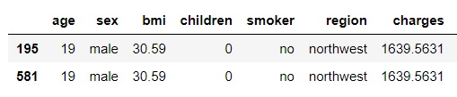
Major Assumptions
Despite the fact that the dataset provided by Axis Insurance was very clean, with no missing data, we believe that there is one duplicate entry. The duplicate will be deleted for statistical analysis purposes.
It is more likely that this is a duplicate entry, rather than there being two males of the same age, from the same region, with identical BMIs and costs billed to Axis Insurance. For this reason, it is assumed to be a duplicate entry and was removed from all testing.
Assumption 1: Duplicate Data Found
Key Recommendation:
Double-check claims records to ensure double payment was not made to this individual!

Slide 7
Major Assumptions
Assumption 2: Randomization Assumption
The 1337 individuals counted in the data set represent a random sample of the larger, American population. This condition is necessary for us to generalize our conclusions about the population.
Assumption 4: Independence Assumption
It is assumed that the data set provided by Axis Insurance contains 1337 distinct and unique samples that are independent. In other words, none of the records are for the same customer at different points in time or are paired samples in any other way.
Assumption 3: Normal Population Assumption
It is assumed that the underlying population, the American population, is normally distributed. The Central Limit Theorem will work unless the data is severely skewed or there are extreme outliers in the population; the assumption is neither is the case

Slide 8
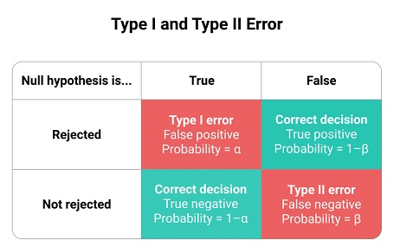
Limitations
CONFIDENCE LEVELS
The confidence levels for all inferential statistical tests conducted in this study is set to 95%. This means that the probability of a Type I error is set to 5% (α) and the probability that the Null Hypothesis is not rejected when true is 95% (1 – α).
In this study, we will control for α, and attempt to keep the probability of a Type I error to 5%.
It is possible to increase the confidence level to 99%, but this would have an adverse affect on the Type II error and increase the probability the Null Hypothesis is not rejected when it should be rejected. The inverse relationship between α and β means that as you seek to reduce one, the probability of the other increases. Therefore, we believe that 95% confidence is an acceptable trade-off for this study.
Source: https://www.scribbr.com/statistics/type-i-and-type-ii-errors/

Slide 9

KEY FINDINGS
02

Slide 10


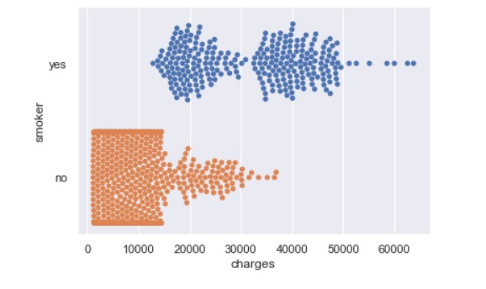
Investigation 1:
Findings:
TRUE
“Medical claims made by the people who smoke are greater than those who don't..."
At the 95% confidence level, there is enough statistically significant evidence to suggest that the individual medical costs billed to Axis Insurance by Smokers is higher than the costs billed by Non-Smokers. The chart to the left shows the disbursement of charges broken down by smoker and non-smoker.

Slide 11
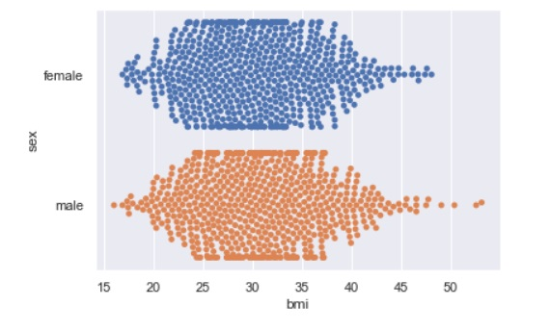
Investigation 2:
Findings:
FALSE
"The BMIs of females is different than that of males...”
The BMIs of females and the BMIs of males are equivalent at the 95% confidence level. The study was unable to find sufficient evidence that the BMIs of females is statistically different than that of males at this level. The visualization to the left shows a very similar shape between the BMIs of females and males.

Slide 12
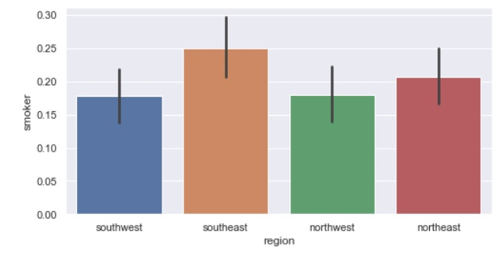
Investigation 3:
Findings:
NO
"Is the Proportion of Smokers Different Across Different Regions?”
Our study shows that there is no statistical difference between the proportion of smokers in any one region compared to any other region. At the 95% confidence level the proportion of smokers is statistically equal in all four regions. The chart to the left visualizes the proportion of smokers in each region. While the bars are clearly not equal, at this confidence level, there is no statistical difference between the regions.

Slide 13
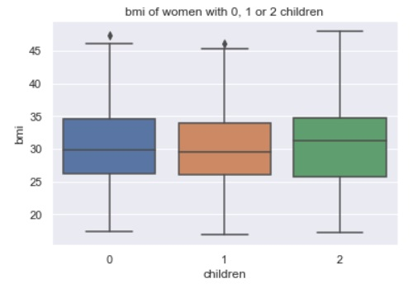
Investigation 4:
Findings:
YES
"Is the mean of BMI of women with no children, one child and two children the same?"
There is sufficient evidence to suggest that the mean BMIs are equivalent. At the 95% confidence level, the mean BMI of women with no children, women with one child and women with two children are NOT statistically different. The chart of the left shows the similarities between the three groups of women and reinforces that they are not significantly different from a visual perspective.

Slide 14
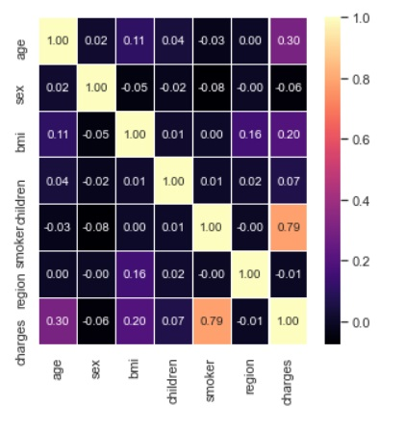
Additional Key Findings
Smokers and Age Correlated with Charges:
The only two variables that show strong correlation (> 0.6) are charges and smoker. The positive nature of the correlation means that charges tend to go up as the likeliness that a customer is a smoker goes up. This strong correlation reinforces the findings for Investigation 1, that medical claims by smokers is higher than those of non-smokers.
There is weak/moderate positive correlation (0.3) between age and charges as well. As the age of a customer increases, so does the average charge.

Slide 15
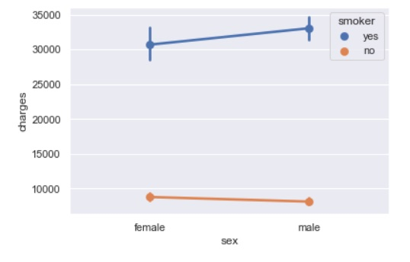
Additional Key Findings
Big Gap between Charges of Smokers vs Charges of Non-Smokers:
The chart to the right shows a big gap between the amount of medical costs billed by smokers vs non-smokers, as expected. The slight negative slope of the orange line suggests non-smokers are slightly less likely to be male. Or, put another way, non-smokers are slightly more likely to be female. The positive slope of the blue suggests smokers are slightly more likely to be male.
Key Recommendation:
Charge smokers higher premiums to cover the higher medical costs associated with smoking

Slide 16
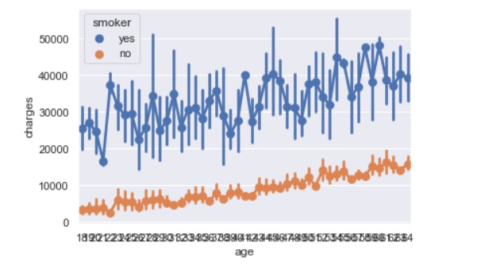
Additional Key Findings
Charges Made by Non-Smokers More Predictable
The chart to the right shows how charges increase as customers ages increase. However, it also shows that gap between smokers (blue) and non-smokers (orange). Not only are the charges made by non-smokers drastically lower, non-smokers’ charges also follow a much tighter distribution pattern. This means, from a strategic perspective, it is much easier to predict and build forecasting models for non-smokers than it is for smokers. The distribution pattern of smokers is much more erratic.
Key Recommendation:
Build predictive payout forecasts using age and non-smoker as key variables

Slide 17
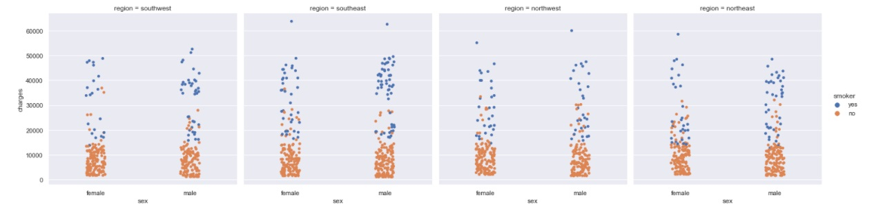
Additional Key Findings
Region and Sex not Good Indicators of Charges
The above categorical plot shows makes it fairly clear that non-smokers, regardless of region or gender, occupy the lower portion of the graphs. Non-smokers GENERALLY make claims under 20,000 dollars. Smokers, however, occupy the top part of the graph, and appear to make most of the claims of greater than 20,000 dollars. This is really important information for an insurance company when setting premiums to ensure that non-smokers are not compensating for the claims of smokers. Smokers make the vast majority of claims over $20,000, regardless of sex or region.

Slide 18
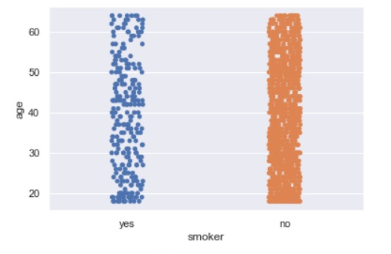
Additional Key Findings
The mean age of non-smokers is HIGHER than the mean age of smokers
The chart to the right shows that the distribution of age between smokers and non-smokers looks equivalent. There are more orange data points because there are more non-smokers (1063 to 274). However, the mean age of smokers is 38.5 years while the mean age of non-smokers is 39.4. This is problematic because it means the non-smokers will age out, on average, sooner, leaving Axis Insurance with more smokers, who typically make much higher claims.
Key Recommendation:
Attempt to reduce the mean age of non-smokers through targeted marketing & educational programs

Slide 19

03
DEMOGRAPHICS

Slide 20
1337
Number of distinct customers who billed individual medical costs to Axis Insurance across all demographics

Slide 21



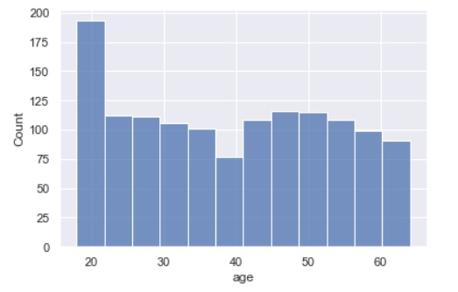
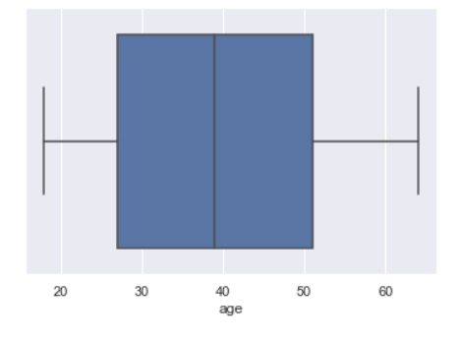
AGE
Range: 18 to 64 years
Mean: 39.22 years
Mode: 18 years
As customers turn 65, they ‘age out’ and transfer to government coverage, so it is important to replace every exiting customer with at least one new customer to maintain current customer base.
Aside from a spike of 18 to 20 year olds, the frequencies are mostly consistent.
All of the ages fall within the four quantiles and there are no outliers
Key Recommendation:
Pay attention to the number of customers who turn 64 each year. Ensure recruitment of new customers is at least equal to departing customers to maintain stability.

Slide 22
SEX
50.49%
49.51%
Male:
675
Female:
GENDER
662
Male and female customers occur with near equal frequency. For Axis Insurance to be a socially responsible corporation, ensure, when all other factors are equal, there is no disparity between premiums charged or claims paid out between the different genders.

Slide 23
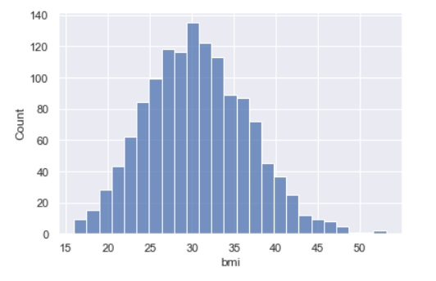
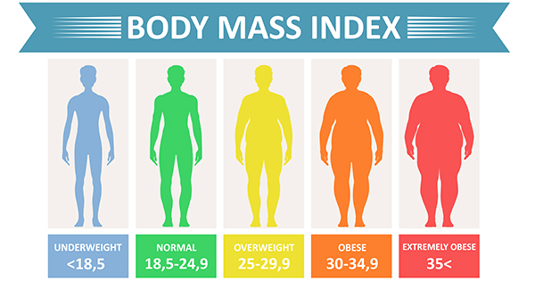
BMI
Min: 15.96
Max: 53.13
Average: 30.66
Body Mass Index (BMI) is a person’s weight in kilograms divided by the square of height in meters. A high BMI can be an indicator of high body fatness.¹
Average BMI is significantly above Axis’ stated ideal range of 18.5 to 24.9.
The above graphic, from CDC, shows that the mean of Axis’s customers is in the ‘obese’ range.
The data for BMI appears to follow a normal distribution, centered close to the average (30.66).
When targeting new customers, aim for persons with
lower BMIs in an attempt to lower the overall average
¹Center for Disease Control and Prevention
Body Mass Index from: CDC.gov
Key Recommendation:

Slide 24
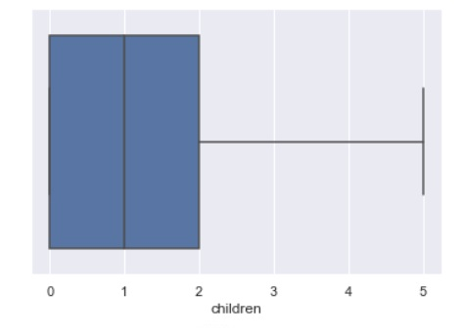
CHILDREN
Min:
0 children
Max:
5 children
Both charts to the right highlight that most customers have 2 or fewer children. The average is 1.09 children per customer. The mode is 0 children; 42.8% of customers have no children.

Slide 25
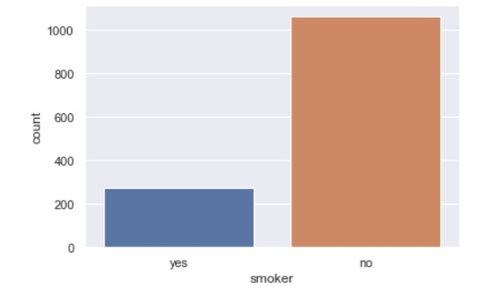



SMOKER
1 in 5 customers are smokers
SMOKER
For Axis Insurance’s purposes, a individual claimant is considered a smoker depending on whether or not the insured regulary smokes tabacco.
NON-SMOKER
274 customers smoke
1063 customers do not smoke
20.49% of customers smoke
79.51% of customers do not smoke

Slide 26
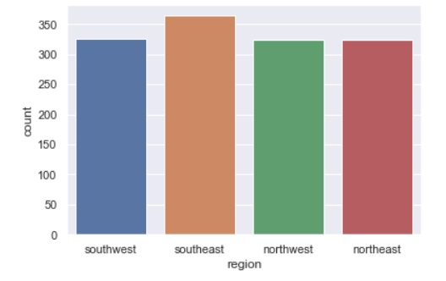
REGION
NORTHEAST: 324
NORTHWEST: 324
SOUTHEAST: 364
SOUTHWEST: 325
The United States has been broken down into four (4) geographic regions: Northeast, Northwest, Southeast and Southwest. While three of the regions have similar customer counts, the Southeast region has about 12% more customers than the others.

Slide 27
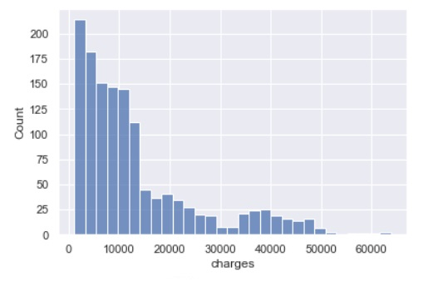
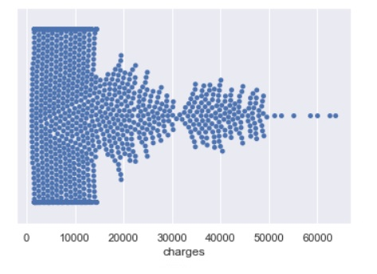
CHARGES
Mean: $13,279.12
Min: $1,121.87
Max: $63,770.43
Median: $9,386.16
Axis pays out, on average, $13,279.12 per claim. Since the max is an outlier, Axis should work on lowering the mean payout in order to decrease expenses and raise profits.
This visualization demonstrates how the charges are dispersed
The chart above shows the data are positively skewed. A large majority of the claims made were under $10,000
Key Recommendation:
Ignore outlier chargers and concentrate on lowering the overall mean of costs billed in order to increase profitability.

Slide 28

INFERENTIAL STATISTICS
04

Slide 29

METHODOLOGY: Setting up the Study
Inferential statistical analysis yields better results on data that is first cleaned and then examined to gain a good understanding of many of the characteristics of the data and the variables. Once the data is understood, critical thinking is essential to apply the appropriate statistical test to answer the question at hand. Different questions require different tests, so it is important to understand exactly what the management team at Axis Insurance is asking in order to attempt to provide an answer. For each of the four questions posed by the Axis Insurance management team, a unique statistical test was applied in an attempt to gain insight. The process for selecting the appropriate test is outlined on the next slide…

Slide 30
METHODOLOGY: Five-Step Process
STEP 1:
STEP 3:
STEP 5:
Formulate the Hypotheses
Identify the test statistic
Decision: Reject or Accept Null Hypothesis
STEP 2:
STEP 4:
Decide the significance level
Calculate p-value (or other test value)

Slide 31


METHODOLOGY: Conclusions
In this study, conclusions are only made regarding the Null Hypothesis at the selected level of significance. It is important to note that the questions, themselves, are not necessarily proved to be “true” or “untrue”, but rather, the Null Hypothesis is either accepted or rejected at the selected confidence level. The confidence level is selected to minimize Type I and Type II errors (see Introduction).
Step 5: Decision
or
Null Hypothesis (H₀)

Slide 32
INVESTIGATION 1: Question
“Medical claims made by the people who smoke are greater than those who don't..."

Slide 33
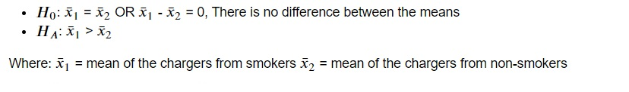
INVESTIGATION 1: Five-Step Process
STEP 1: Formulate the Hypotheses
Based on the way the question is phrased, there is an implied assumption that smokers make greater claims than non-smokers. Therefore, we set the Alternate Hypothesis to reflect this assumption and the Null Hypothesis will be that the mean charges of smokers is less than or equal to the mean charges of non-smokers.
STEP 2: Decide the significance level

Slide 34
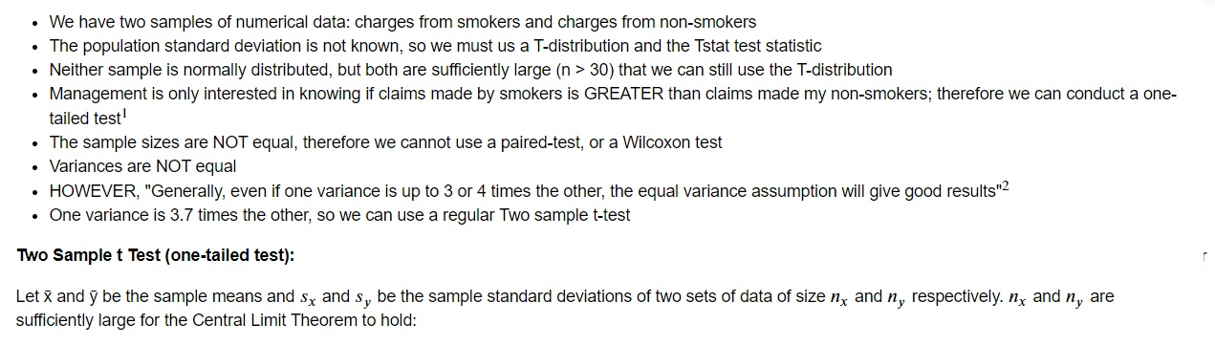
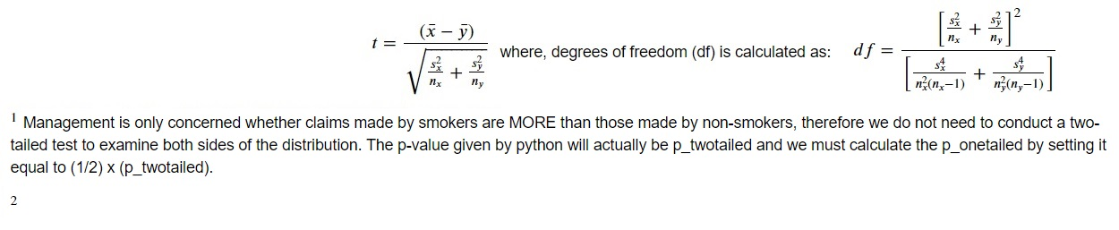
INVESTIGATION 1: Five-Step Process
STEP 3: Identify the test statistic
https://www.real-statistics.com/students-t-distribution/two-sample-t-test-uequal-variances/

Slide 35
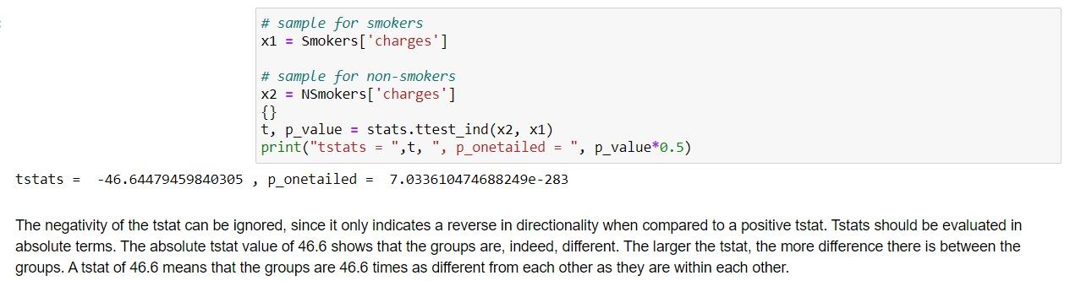
INVESTIGATION 1: Five-Step Process
STEP 4 : Calculate p-value
STEP 5: Decision: Reject or Accept Null Hypothesis
Since P_onetailed (7.03e-283) << 0.05 (alpha) we reject the null hypothesis and conclude that there is a statistically significant difference between the two means at the 95% confidence level.

Slide 36
INVESTIGATION 1: Conclusion
We have demonstrated that the means are not equal with relative certainty. Our confidence level is set to 0.05, or 95% and the null hypothesis is rejected at this confidence level. We can accept the Alternate Hypothesis that there is a difference between the means of charges between smokers and non-smokers. Because we used a one-tailed test, we can also demonstrate with certainty that the mean charges of smokers is GREATER than the mean chargers of non-smokers. The t-stat reinforces this, because we can interpret it as meaning that there is almost 47 standard deviations between the two means.

Slide 37
INVESTIGATION 1: Supplementary Question
“How much greater are the medical claims made by the people who smoker?”

Slide 38
INVESTIGATION 1: Supplementary Question
Supplementary Question:
“How much greater are the medical claims made by the people who smoker?”
Problem:
A hypothesis test does not tell us anything about the size of the difference between the mean of medical claims made by people who smoke is greater than the mean of those who do not, it just shows that there is a difference between the two means.
Approach:
A confidence interval gives a range of likely scenarios, which is exactly the type of information businesses need to make informed decisions. A confidence interval for the difference in means can be constructed by starting with the observed statistic and then adding and subtracting a multiple of the standard error, where the multiple is based on the t-distribution.

Slide 39
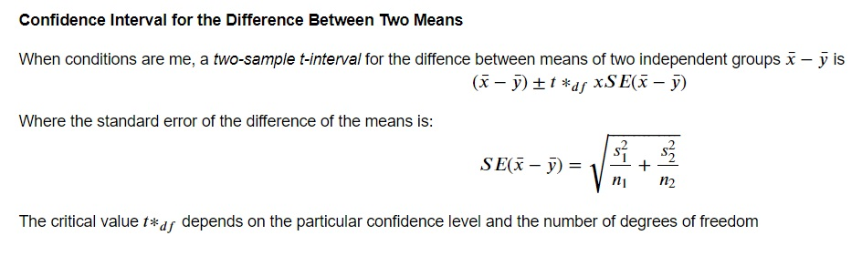
INVESTIGATION 1: Supplementary Question
Mechanics:
Results:
The results from Investigation 1 yielded an observed difference between the two means of $23,609.57. Further analysis gives a 95% confidence interval of ($22,603.23, $24,615.91). In other words, it is expected with 95% confidence that under similar conditions the mean difference between medical claims made by smokers will be between $22,603.23 and $24,615.91 higher than non-smokers
Source: Sharpe, N., et al. (2014). Business Statistics. 2nd Canadian Edition. Toronto: Pearson

Slide 40
INVESTIGATION 1: Supplementary Question
Using the above approach, we were able to show the size of the difference between the two means with 95% certainty. The confidence interval shows that the mean difference between medical claims made by smokers will be between $22,603.23 and $24,615.91 higher than non-smokers at this confidence level.

Slide 41
INVESTIGATION 2: Question
“The BMI of females is different from that of males...”

Slide 42
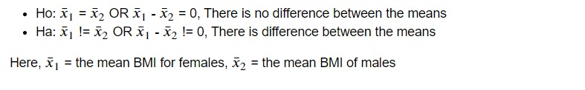
INVESTIGATION 2: Five-Step Process
STEP 1: Formulate the Hypotheses
Similarly, the second question to be investigated already has an assumed outcome. The assumption, based on the wording of the question, is that the BMI of females IS different from the BMI of males. This assumption is beyond what we already know from exploratory data analysis, therefore, we can set the Alternate Hypothesis to reflect this assumed outcome:
STEP 2: Decide the significance level

Slide 43
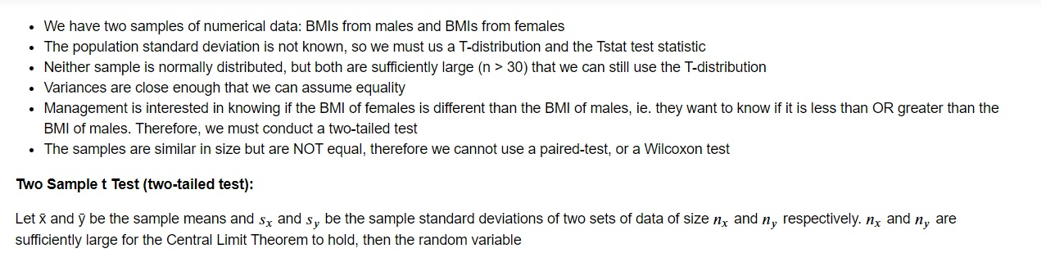
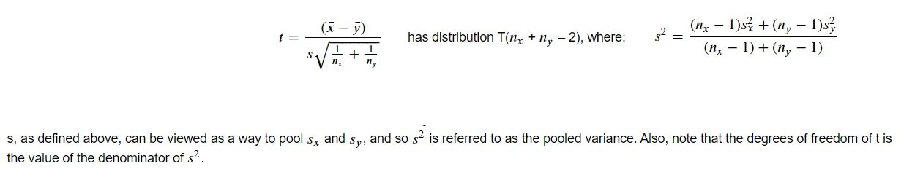
INVESTIGATION 2: Five-Step Process
STEP 3: Identify the test statistic
Source: https://www.real-statistics.com/students-t-distribution/two-sample-t-test-equal-variances/

Slide 44
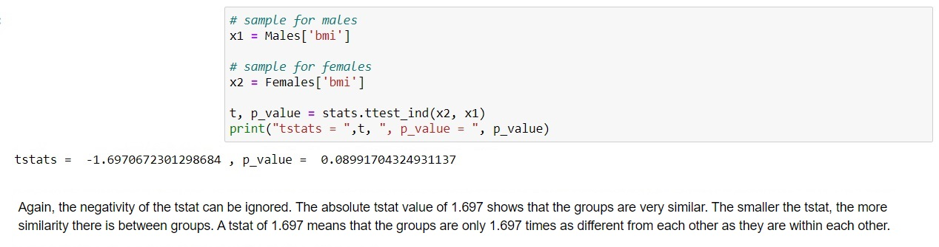
INVESTIGATION 2: Five-Step Process
STEP 4 : Calculate p-value
STEP 5: Decision: Reject or Accept Null Hypothesis
Since p-value = 0.0899 > 0.05 (alpha) we cannot reject the null hypothesis. Therefore, we conclude that there is no statistical difference between the two means at the 95% confidence level. In other words, there is no difference between the BMI of females and the BMI of males at the 95% confidence level.

Slide 45
INVESTIGATION 2: Conclusion
Using the above approach, we have demonstrated that the means are approximately equal with relative certainty. Our confidence level is set to 0.05, or 95% and the null hypothesis cannot be rejected at this confidence level. Therefore, there is no difference between the BMI of females and the BMI of males. The small t-stat also suggests that there is less than 2 standard deviations between the mean of BMI of females and the mean of BMI for males.

Slide 46
INVESTIGATION 3: Question
"Is the Proportion of Smokers Different Across Different Regions?"

Slide 47
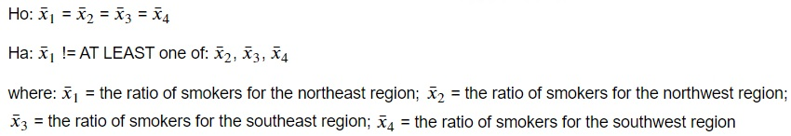
INVESTIGATION 3: Five-Step Process
STEP 1: Formulate the Hypotheses
There is no previously stated assumption made by Axis stating that the regions are not equal or that at least one region is not equal to the others, so the Null Hypothesis would be that all regions are equal. Conversely, the Alternate Hypothesis will be that AT LEAST one region is not equal to the others.
STEP 2: Decide the significance level

Slide 48
INVESTIGATION 3: Five-Step Process
STEP 3: Identify the test statistic
At first glance, an equal distribution would mean that 25% of ALL smokers are present in EACH region. However, this would only be true IF all regions are equal in size. We already know from univariate analysis of the region data that this is not the case. We can approach this problem two ways: by calculating the distribution of the expected values and testing to see if the groups match this distribution (chi square goodness of fit test) or we can assume that we do not know the underlying distribution but want to test whether the groups have the same distribution (chi square test of independence). We can, therefore, attempt to answer this question in two different ways:
Method 1:
Find the observed values of smokers for each region
Calculate the expected values for each region: (total number of smokers/total customers) x total customers per region
Run a Chi square goodness of fit test using the expected numbers calculated above against the observed numbers in each region
Method 2:
Create distinct data frames for each region
Create Contingency Tables showing values for the number and proportion of smokers and non-smokers in each region
Perform a Chi square test of independence using a contingency table showing the frequency of smokers to the number of total customers in each specific region

Slide 49
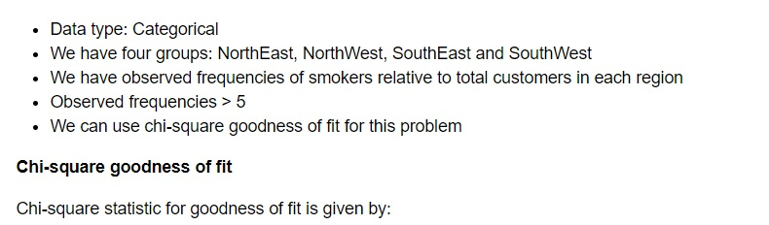
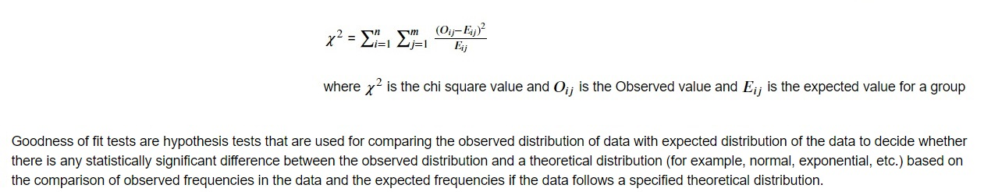
INVESTIGATION 3: Five-Step Process
METHOD 1
STEP 3: Identify the test statistic
METHOD 1:
Source: Anova and Chi square-1.ipynb (available at: https://olympus.greatlearning.in/courses/29240)

Slide 50
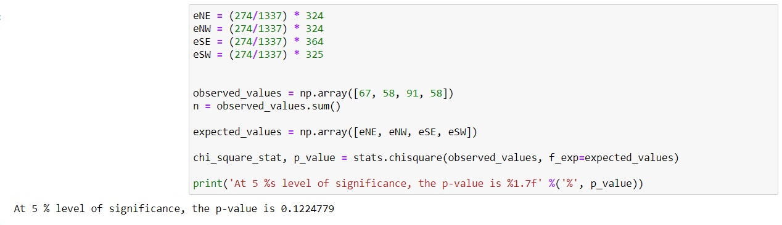
INVESTIGATION 3: Five-Step Process
METHOD 2
STEP 4 : Calculate p value or chi-square statistic value
STEP 5: Decision: Reject or Accept Null Hypothesis
The p value is 0.1225 and is > than 0.05, therefore we cannot reject the null hypothesis. The proportion of smokers in each region are statistically equal at the 95% confidence level.

Slide 51
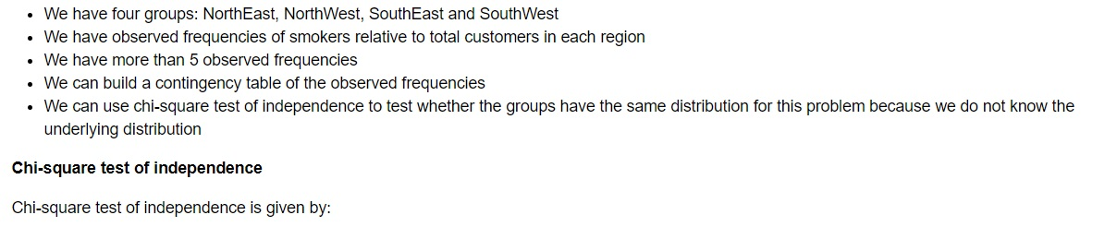
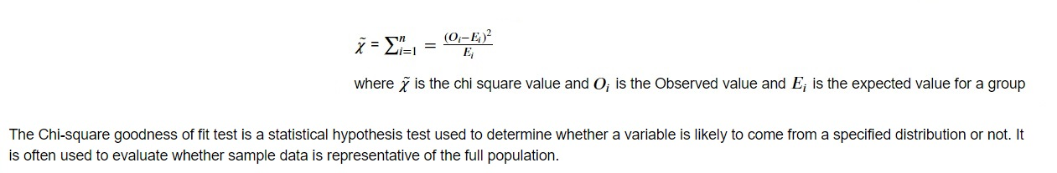
INVESTIGATION 3: Five-Step Process
METHOD 1
STEP 3: Identify the test statistic
METHOD 2:
Source: https://www.jmp.com/en_ca/statistics-knowledge-portal/chi-square-test/chi-square-goodness-of-fit-test.html#:~:text=The%20Chi%2Dsquare%20goodness%20of%20fit%20test%20is%20a%20statistical,representative%20of%20the%20full%20population.

Slide 52
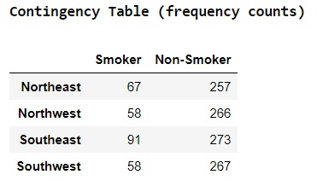
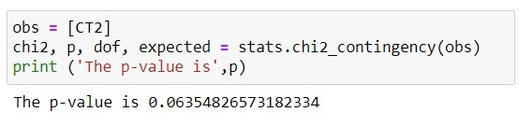
INVESTIGATION 3: Five-Step Process
METHOD 2
STEP 4 : Calculate p-value
The above code uses the contingency table on the right [CT2] to calculate a p-value using chi square test of independence.
STEP 5: Decision: Reject or Accept Null Hypothesis
The p value is 0.0635 and it is greater than our chosen level of significance at 5%. Using Method 2, we cannot reject the null hypothesis at 5% level of significance. The proportion of smokers in each region is equal to the proportion of smokers in every other region at this level of significance.

Slide 53
INVESTIGATION 3: Conclusion
Using either method, the p-value is of the Chi square tests are greater than 0.05, so we cannot reject the null hypothesis at the 95% confidence level. What this means is that there is no statistical difference between the proportion of smokers across different regions. For statistical purposes, at the 95% confidence level, the four regions have the same proportion of smokers.
Method 2, the Chi square test for independence, is probably the superior test for this question because it tests to see if the proportion of smokers in the different regions have the same distribution and whether they are representative of the full population. At the 95% confidence level, the Chi square test for independence [stats.chi2_contingency()] shows there is enough statistical evidence to accept the null hypothesis: there is no statistical difference between the distributions of smokers in each region and they are representative of the full population.

Slide 54
INVESTIGATION 4: Question
"Is the mean of BMI of women with no children, one child and two children the same?"

Slide 55
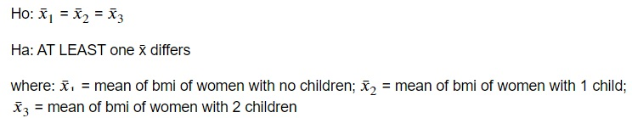
INVESTIGATION 4: Five-Step Process
STEP 1: Formulate the Hypotheses
There is no implied assumption based on the wording of the questions, so the Null Hypothesis may be set first, stating that the mean BMI of all three groups of women are statistically equivalent. The alternate hypothesis will state that at least one of the means is different.
STEP 2: Decide the significance level

Slide 56
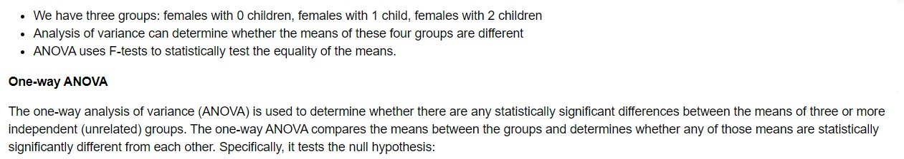
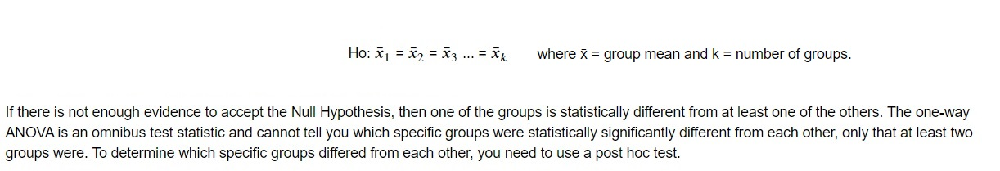
INVESTIGATION 4: Five-Step Process
STEP 3: Identify the test statistic
Source: https://statistics.laerd.com/statistical-guides/one-way-anova-statistical-guide.php

Slide 57
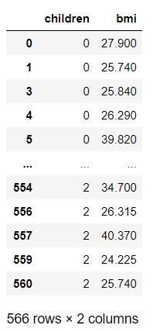
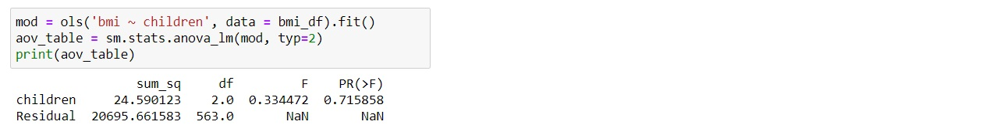
INVESTIGATION 4: Five-Step Process
METHOD 2
Steps to Conduct Anova Test
STEP 4 : Calculate p-value
Determine the count, mean and standard deviation for each variable of interest
Create a data frame of women with 0, 1 and 2 children, and their corresponding BMIs
Third, we can create a visual boxplot of the data
Fourth, we can conduct the ANOVA test using python
The above code uses the data frame bmi_df (far right) which only includes females with 0, 1 or 2 children and their corresponding BMIs. It was created using the steps to the right.
STEP 5: Decision: Reject or Accept Null Hypothesis
The p value is 0.7159 and which is greater than 0.05, our chosen level of significance at 95%. Therefore, the statistical decision is that we cannot reject the null hypothesis at 95% level of significance. There is no statistical difference between the BMIs of the 3 groups of women.

Slide 58
INVESTIGATION 4: Conclusion
There is sufficient evidence to suggest that we cannot reject the null hypothesis, which states that the mean BMIs are statistically equivalent. At the 95% confidence level, the mean BMI of women with no children, women with one child and women with two children are NOT statistically different.

Slide 59
RECOMMENDATIONS
05

Slide 60
Recommendations based on Investigation Question 1
Recommendation:
Create an equitable, pay-per-use, premium structure so that non-smokers are not being charged the same as smokers.
Ensure medical claims made by smokers are being funded by premiums paid by smokers
Rational:
It is unfair for smokers and non-smokers to be charged the same premiums for coverage when smokers made substantially larger claims, on average.
Non-smokers will shop around for cheaper insurance, and a drop in the proportion of non-smokers would decrease profitability
The mean charge claimed by smokers is $32,050, while the mean charge claimed by non-smokers is $8441. To relect this difference, premiums paid by smokers should be proportionally higher than those paid by non-smokers. Premiums paid by smokers should be 3.8x higher than non-smokers.

Slide 61
Recommendations based on Investigation 1: Supplementary Question
Recommendation:
Create forecasting models of predicted claim payouts based on the confidence interval of how much greater the mean charges of smokers are compared to non-smokers
Rational:
We can see from the graph on the right that medical claims by non-smokers has a much smaller variation than that of smokers
Combining this knowledge with our findings that the mean difference between medical claims made by smokers will be between $22,603.23 and $24,615.91 higher than non-smokers at this confidence level could help create more reliable forecasts
Adding a trendline to the non-smokers data (orange) shows the approximate mean charge at each age level. By duplicating the trendline and adding $24,615.91 to the mean at each age level, we get an upper limit trendline (red). By duplicating the original trendline and adding $22,603.23 to the mean at each age level, we get a lower limit trendline (yellow). This creates a smoothing effect on the mean charge of smokers at each age level

Slide 62
Recommendations based on Investigation Question 2
Recommendation:
Ensure, all else being equal, females are charged the same premiums as males
Ensure, all else being equal, females are allowed to bill the same medical costs as males
Rational:
In today’s politically charged climate, it is important that Axis Insurance establishes itself as a leader in social responsibility, and this includes equity between genders
Failure to achieve gender parity could lead to an exodus of existing customers, competitive disadvantage when soliciting new customers, and potential legal liabilities.
The mean charge claimed by males is $13,975, while the mean charge claimed by women is $12,570. Men are slightly more likely to be smokers than women. Taken together, premiums should be set so that male and females should be charged the same at two different levels: smokers and non-smokers. The higher number of male smokers should mean that more premiums will cover their higher mean charge claimed.

Slide 63
Recommendations based on Investigation Question 3
Recommendation:
Premiums should not be the same across the different geographic regions just because the proportions of smokers and non-smokers are statistically equivalent
Further studies should be conducted to determine i) if there is a statistically significant difference between the charges of the four different regions ii) if other factors such as BMI help explain any difference
Rational:
The study showed the proportion of smokers is not statistically different by region, but it does not necessarily mean premiums should be the same, all else being equal, regardless of region
Charges may be higher in some regions because the average BMI is higher, or outside factors such as higher wages for medical professionals are driving costs up.
The mean charge claimed by customers in the southeast is the highest at $14,735 and lowest in the southwest at $12,347. Despite the proportion of smokers in each region being equal, premiums paid in the southwest should be higher than premiums paid in other regions.

Slide 64
Recommendations based on Investigation Question 4
Do not penalize women who have children.
Create an opportunity to offer additional coverage on a per additional child basis
Recommendation:
Rational:
Again, Axis Insurance can establish itself as a leader in equality by not discriminating against women with children. The evidence shows women with 0, 1 or 2 children enjoy the same level of health (as determined by BMI)
Parents (male or female) should not be charged for having children, but additional coverage can be extended to their children for a price
The above chart includes males and females. The average claim made by individuals with 2 or 3 children is higher than claims made by individuals with 0 or 1 child(ren). More data is needed to determine if the charges made by these individuals is personal only or includes medical costs for the children as well. Adding a small premium to extend coverage per each additional child would make up the difference between the average claims of individuals with 0 children and those with more. Note: individuals with 4 and 5 children have very small sample sizes (<30).

Slide 65
Additional Recommendations
Reducing fraud saves money
Recommendation:
Test for fraudulent claims
Target younger, healthier, non-smokers to replace 60 year old+ customers
Focus on lowering mean cost of claims
Targeting younger, healthier, non-smokers will reduce claims
Rational:
Reduce risk of overpaying or double-paying claimants (need highlighted by duplicate in data set provided by Axis Insurance)
As customers grow older and reach 65, they transfer to government coverage. New customers must be recruited to replace the ones that leave. Ideally, younger, healthier (lower BMI), non-smokers should be targeted in an effort to minimize expenses, which leads to higher profitability. This may also help Axis to lower premiums and become more competitive.
While its tempting to focus on lowering the highest claims, data shows that there are only a few outliers above the $50,000 threshold. It would be more profitable to focus on lowering the overall mean by $50 than focusing on lowering the top claims by $500.
Lowering the mean by even a few dollars translates into $1000s in savings

Slide 66
Additional Recommendations
Recommendation:
Introduce non-smoking campaigns
Test for other factors: drugs, alcohol, etc.
Non-smoking campaigns could lower costs over the long run
Rational:
Education is a key component to lowering overall costs. Claims made by smokers are significantly higher than claims made by non-smokers, so investing in educational programs to make people aware of the health-risks involved, and incentivizing them by showing the potential savings they could obtain by quitting, would be a long-term strategy to reduce future payouts.
The data shows the harmful affect smoking has on health care costs. Other factors such as alcohol, marijuana and other recreational drugs may have similar adverse affects but no data is currently available. This information may help predict non-smokers who make higher-than-average claims or perhaps there is a compounding affect and the highest claims are actually made by smokers who also partake in other unhealthy habits.
Testing for alcohol and drug use could prevent subsidization of associated medical costs by non-users

Slide 67
06
CONCLUSIONS

Slide 68
INVESTIGATION 1
QUESTION: “Medical claims made by the people who smoke are greater than those who don't..."
STEP 1: Formulate the Hypotheses → H₀: x̄₁ = x̄₂, H_{A}: x̄₁ > x̄₂
STEP 2: Decide the significance level → α = 0.05
STEP 3: Identify the test statistic → Two sample T-test, unequal variances (one-tailed)
STEP 4 : Calculate p-value → p_onetailed = 7.03e-283
STEP 5: Decision → p_onetailed = 7.03e-283 < p = 0.05 → REJECT
CONCLUSION: Medical claims made by smokers is higher than non-smokers

Slide 69
INVESTIGATION 2
QUESTION: “The BMI of females is different from that of males...”
STEP 1: Formulate the Hypotheses → H₀: x̄₁ = x̄₂, H_{A}: x̄₁ != x̄₂
STEP 2: Decide the significance level → α = 0.05
STEP 3: Identify the test statistic → Two sample T-test, equal variances (two-tailed)
STEP 4 : Calculate p-value → p = 0.0899
STEP 5: Decision → p = 0.0899 > α = 0.05 → FAIL TO REJECT
CONCLUSION: The BMI of females is not statistically different from the BMI of males

Slide 70
INVESTIGATION 3
QUESTION: "Is the Proportion of Smokers Different Across Different Regions?"
STEP 1: Formulate the Hypotheses → H₀: x̄₁ = x̄₂ = x̄₃ = x̄₄, H_{A}: x̄₁ != AT LEAST one: x̄₂, x̄₃, x̄₄
STEP 2: Decide the significance level → α = 0.05
STEP 3: Identify the test statistic →
i) Chi square (goodness of fit) ii) Chi square (test for independence)
STEP 4 : Calculate p-value →
i) p₁ = 0.1225 ii) p₂ = 0.5070
STEP 5: Decision → p₁ & p₂ > α = 0.05 → FAIL TO REJECT
CONCLUSION: The proportion of smokers is not statistically different across different regions.

Slide 71
INVESTIGATION 4
QUESTION: "Is the mean BMI of women with no children, one child and two children the same?"
STEP 1: Formulate the Hypotheses → H₀: x̄₁ = x̄₂ = x̄₃, H_{A}: AT LEAST one: x̄ differs
STEP 2: Decide the significance level → α = 0.05
STEP 3: Identify the test statistic → One-way ANOVA test
STEP 4 : Calculate p-value → p = 0.7159
STEP 5: Decision → p > α = 0.05 → FAIL TO REJECT
CONCLUSION: The mean BMI of women with 0, 1 and 2 children are statistically equivalent

Slide 72
OVERALL CONCLUSIONS
Individual medical costs billed to health insurance (charges) are substantially higher for smokers
Charges increase moderately as a customer ages
Charges made by non-smokers can be more accurately predicted as the customer ages compared to smokers
BMI is moderately correlated to charges but not statistically deferent between females and males, nor between females with 0, 1 or 2 children
The mean age of non-smokers is higher than the mean age of smokers
Smoker is the best variable for setting premium prices, which should be tiered for smokers and non-smokers

Slide 73
Going Forward
Further studies should be conducted to test the following:
Is the BMI of smokers is statistically different than the BMI of non-smokers?
The correlation between BMI and charges
The correlation between age and charges
By studying these different variables, it would be possible to build a regression analysis forumla that could predict, with relative accuracy, the expected charges a customer would make based on the variables provided in the data set. Premiums could then be set on a customer basis based on expected charges.
By having a reliable forecasting tool, Axis Insurance can mitigate against risk, predict liabilities, and better manage cash flow.

Slide 74
07
SUPPORTING DATA

Slide 75
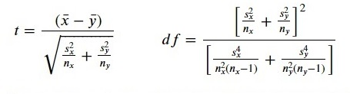
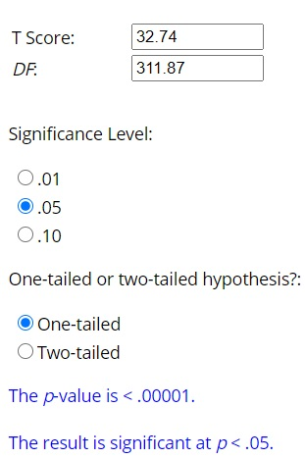
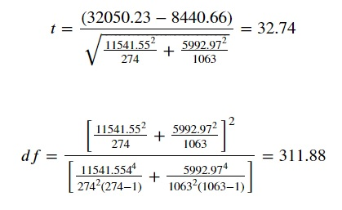
Supporting Data for Investigation Question 1
Two Sample t Test (one-tailed test):
Using the outputs calculated by python, we can substitute actual values into the formulas for the tstat and degrees of freedom:
x̄ = 32050.23, ȳ= 8440.66, s_{x} = 11541.55, s_{y} = 5992.97, n_{x} = 274 and n_{y} = 1063
Solving, t = 32.74 with df = 311.88
Using an online p-value calculator, for t = 32.74 with df = 311.88, p-value is < 0.00001
Limitations:
The very small p value tells us that the means are not equal, and because it is a one-tailed test, we know that the mean charges of smokers is greater than the mean charges of non-smokers…
BUT… this test does not tell us how much bigger the mean chargers of smokers is compared to the mean charges of smokers
Source: https://www.socscistatistics.com/pvalues/tdistribution.aspx

Slide 76
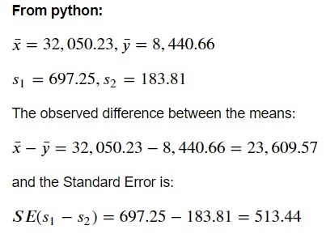
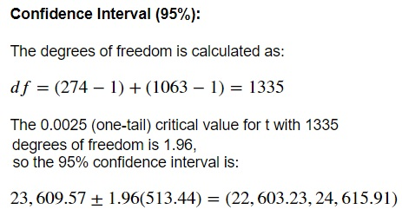
Supporting Data for Investigation Question 1
Confidence Interval: Difference Between Two Means
We can state with 95% confidence that the medical claims made by smokers are between $22,603.23 and $24,615.91 more than medical claims made by non-smokers.
Using the outputs calculated by python, we can calculate the observed difference, the standard error and the 0.025 critical value for t:
Source: Sharpe, N., et al. (2014). Business Statistics. 2nd Canadian Edition. Toronto: Pearson

Slide 77
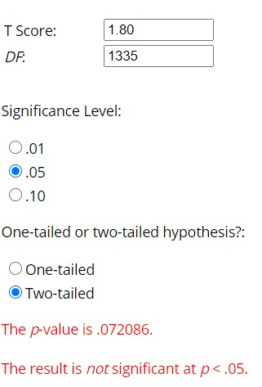
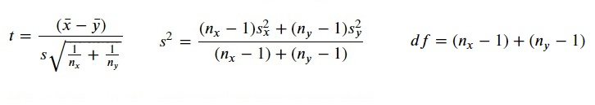
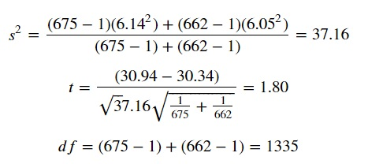
Supporting Data for Investigation Question 2
Two Sample t Test (one-tailed test):
Using the outputs calculated by python, we can substitute actual values into the formulas for the tstat and degrees of freedom:
x̄ = 30.94, ȳ= 30.34, n_{x} = 675 and n_{y} = 662
Solving, t = 1.80 with df = 1335
Using an online p-value calculator, for t = 1.80 with df = 1335, p-value is 0.072086
Limitations:
The p-value tells us there is no difference between the means at 95% confidence.
We could re-run this test at 99% confidence to see if the means are different at that level…
BUT… by decreasing α we risk increasing β, and thus increasing the risk of a Type II error
Note: the values to the right are similar but not equal to the results from python, this is due to rounding errors when calculated by hand
Source: https://www.socscistatistics.com/pvalues/tdistribution.aspx

Slide 78
Supporting Data for Investigation Question 3
Method 1: GOODNESS-OF-FIT TEST
Data for a goodness-of-fit testare organized in tables
The tables are organized as summary counts in each category.
Here, we have 274 individual smokers organized by region
The data set provides the Observed number of smokers/region
An equal distribution would mean there are 25% in each region
BUT… the number of customers in each region is slightly different so to calculate the Expected number of smokers per region we must use the following formula:
E_{region} = (total smokers/total customers) x customers per region
Region | Obs | Exp | (Obs-Exp) | (Obs-Exp)² | (Obs - Exp)² Exp
Northeast | 67 | 66.40 | 0.60 | 0.36 | 0.01
Northwest | 58 | 66.40 | -8.40 | 70.55 | 1.06
Southeast | 91 | 74.60 | 16.40 | 269.06 | 3.61
Southwest | 58 | 66.60 | -8.60 | 74.03 | 1.11
Limitations:
The goodness-of-fit test compares the Observed values with Expected values, not with other observed values in different regions.
This means we are testing the proportion of smokers against a target of 20.49% (total smokers/total customers)
Essentially, we are concluding that, because each region is not statistically different from the 20.49% target, each region is statistically equivalent, however, this might not actually be true.
Two regions could still be statistically equivalent to 20.49% at α = 0.05 but not statistically equivalent to each other.
The chi-square statistic (χ²) is the sum of the last column (5.79). The degrees of freedom (df) for the test is the number of regions minus one or 3. At the 95% significance level, with df = 3, χ²_{α} = 7.815. This means the test would need a value of 7.815 or more to have a p-value less than 0.05.

Slide 79

Supporting Data for Investigation Question 3
Method 1: GOODNESS-OF-FIT TEST (Continued)
The chi-square statistic (χ²) is the sum of the last column
Χ² = 5.79, with 3 degrees of freedom
At the 95% significance level, with df = 3, χ²_{α} = 7.815.
This means the test would need a value of 7.815 or more to have a p-value less than 0.05.
Using an online p-value calculator, for χ² = 5.79 with df = 3, p-value is 0.063548
0.063548 > 0.05 therefore, fail to reject Ho
Region | Smoker
Northeast | 0.005433
Northwest | 1.062509
Southeast | 3.606895
Southwest | 1.111559
To calculate the degrees of freedom (df): (rows -1) df: (4 -1) = 3
Source: https://www.socscistatistics.com/pvalues/chidistribution.aspx

Slide 80


Supporting Data for Investigation Question 3
Method 2: TEST OF INDEPENDENCE
Mechanically, a Chi square test of independece is nearly identical to the Chi square goodness-of-fit test, but instead of comparing Observed counts to Expected counts from a given model, the test for independence examines the difference between the Observed counts and the Expected counts under the assumption of homogeneity
The terms homogeneity and independence can be used interchangeably to establish equivalent null hypotheses:
In terms of homogeneity: H₀: the proportion of smokers is the same across regions
In terms of independence: H₀: the proportion of smokers is independent of regions
Since the test of independence tests to see if the proportion of smokers in the different regions have the same distribution and whether they are representative of the full population, it goes further in answering investigation question 3 than the goodness-of-fit test
If the distributions are the same, we would expect each cell to have expected values that are 20.49% (274/1337) and 79.51% (1063/1337) of the row totals for smoker and non-smoker, respectively. Expected: (TotalRow x TotalCol) / Total Table

Slide 81

Supporting Data for Investigation Question 3
Method 2: TEST OF INDEPENDENCE (Continued)
Region | Smoker | Non-Smoker
Northeast | 0.005433 | 0.0014
Northwest | 1.062509 | 0.273873
Southeast | 3.606895 | 0.929717
Southwest | 1.111559 | 0.286517
The test of independence can test the distribution of smokers and non-smokers to see if it appears to be the same in each region
The sum of each cell becomes the χ² value
Therefore, χ² = 7.277902
Using an online p-value calculator, for χ² = 7.277902 with df = 3, p-value is 0.063548
0.063548 > 0.05 therefore, fail to reject Ho
To calculate the degrees of freedom (df): (columns – 1) x (rows -1) df: (2-1) x (4 -1) = 3
Source: https://www.socscistatistics.com/pvalues/chidistribution.aspx

Slide 82

Supporting Data for Investigation Question 4
One-way ANOVA
One-way ANOVA compares the means of two or more independent groups in order to determine whether there is statistical evidence that the associated population means are significantly different.
The test was run using data from three independent groups: women with 0 children, 1 child and 2 children
It tests to see if there is statistical evidence to show that the mean BMIs of these groups of women are significantly different
Source: Sharpe, N., et al. (2014). Business Statistics. 2nd Canadian Edition. Toronto: Pearson

Slide 83
Supporting Data for Investigation Question 4
One-way ANOVA (Continued)
Level | Count | Mean | Std Dev | Std Err Mean | Lower 95% | Upper 95%
0 Children | 289 | 30.36 | 16.36 | 0.35 | 21.55 | 40.23
1 Child | 158 | 30.05 | 5.77 | 0.46 | 21.52 | 39.93
2 Children | 119 | 30.65 | 6.63 | 0.61 | 19.90 | 42.72
 | Sum of Squares | Degrees of Freedom | F Ratio | Probability > F
BMI | 24.59 | 2 | 0.33 | 0.715858
Residual | 20695.66 | 563 | NaN | NaN
The large p-value (0.72 > 0.05) means we cannot reject the null hypothesis
* Both tables populated with data retrieved from python

Slide 84
BIBLIOGRAPHY
About Adult BMI. Available at: https://www.cdc.gov/healthyweight/assessing/bmi/adult_bmi/index.html
Anova and Chi square-1.ipynb. Available at: https://olympus.greatlearning.in/courses/29240
Chi-Square Goodness of Fit Test. Available at: https://www.jmp.com/en_ca/statistics-knowledge-portal/chi-square-test/chi-square-goodness-of-fit-test.html
One-way ANOVA. Available at: https://statistics.laerd.com/statistical-guides/one-way-anova-statistical-guide.php
P Value from Chi-Square Calculator. Available at: https://www.socscistatistics.com/pvalues/chidistribution.aspx
P Value from T Score Calculator. Available at: https://www.socscistatistics.com/pvalues/tdistribution.aspx
Sharpe, N., et al. (2014). Business Statistics. 2nd Canadian Edition. Toronto: Pearson
Two Sample t Test: equal variances. Available at: https://www.real-statistics.com/students-t-distribution/two-sample-t-test-equal-variances/
Two Sample t Test: unequal variances. Available at: https://www.real-statistics.com/students-t-distribution/two-sample-t-test-uequal-variances
Type I and Type II Errors. Available at: https://www.scribbr.com/statistics/type-i-and-type-ii-errors/

Slide 85

THANK YOU!
Do you have any questions?
scott@mullinresearch.com
+1 800 767 7766
mullinresearch.com

